Slide 1

PIZZA SALES ANALYSIS
Insights from SQL Queries

Slide 2
PROJECT PURPOSE AND OBJECTIVES:
The purpose of this project was to conduct a comprehensive analysis of pizza sales data using SQL queries in MySQL. The primary objectives were to gain insights into the sales performance of pizzas and address key business questions related to revenue generation, order patterns, and pizza preferences.

Slide 3
TOPICS COVERED
BASIC ANALYSIS
INTERMEDIATE ANALYSIS
ADVANCED ANALYSIS
Retrieve the total number of orders placed.
Calculate the total revenue generated from pizza sales.
Identify the highest-priced pizza.
Identify the most common pizza size ordered.
List the top 5 most ordered pizza types along with their quantities.
Determine the distribution of orders by hour of the day.
Determine the total quantity of each pizza category ordered.
Determine the category-wise distribution of pizzas.
Group the orders by date and calculate the average number of pizzas ordered per day.
Determine the top 3 most ordered pizza types based on revenue.
Calculate the percentage contribution of each pizza type to total revenue.
Analyze the cumulative revenue generated over time.
Determine the top 3 most ordered pizza types based on revenue for each pizza category.

Slide 4

DATA OVERVIEW
DATASET DESCRIPTION:
Pizza Table:
This dataset contains information about different pizzas available for sale, including the pizza ID, pizza type ID, size, and price.
Pizza Type Table:
This dataset provides details about pizza types, such as the pizza type ID, name, category, and ingredients.
Orders Table:
This dataset records information about orders placed, including the order ID, date, and time.
Orders Detail Table:
This dataset contains detailed information about each order, including the order details ID, order ID, pizza ID, and quantity.

Slide 5
DATA CLEANING AND PREPROCESSING:
The data was initially provided in CSV format and was cleaned using Excel.
Data cleaning steps included removing duplicate entries and empty cells to ensure data integrity.
By cleaning the data, we ensured that the datasets were free from inconsistencies and ready for analysis using SQL.

Slide 6


BASIC ANALYSIS RESULTS
TOTAL ORDERS
Revenue
21350
$ 817860.05

Slide 7
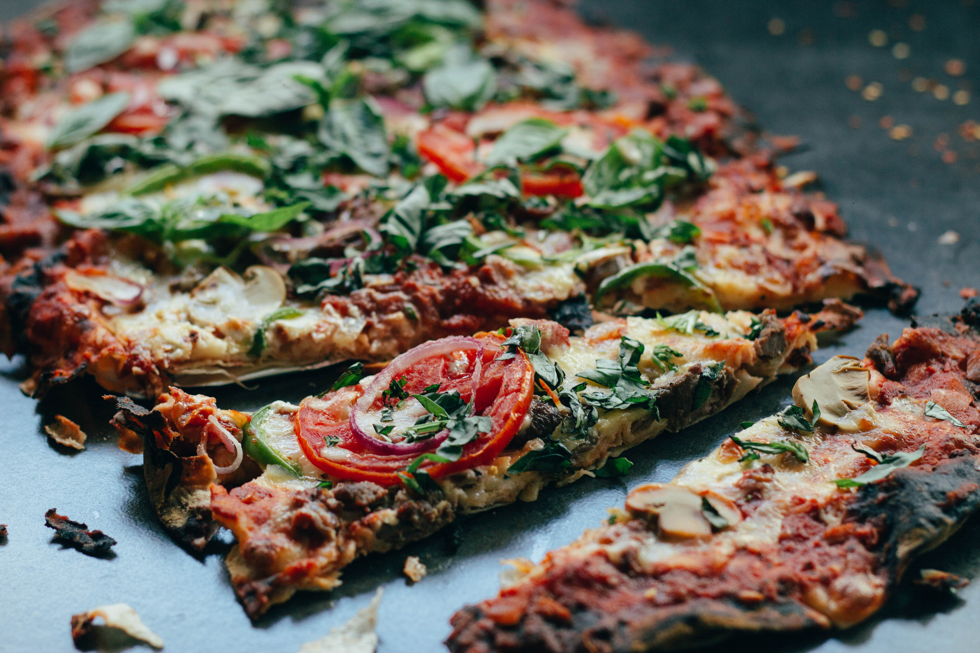
HIGHEST-PRICED PIZZA
THE GREEK PIZZA
MOST COMMON SIZE
LARGE SIZE

Slide 8





TOP FIVE ORDERED PIZZA
TOP FIVE REASONS
The Classic
Deluxe Pizza
The Barbecue Chicken Pizza
The Hawaiian Pizza
The Pepperoni Pizza
The Thai Chicken Pizza

Slide 9

INTERMEDIATE ANALYSIS RESULTS
DISTRIBUTION OF ORDERS
BY HOUR
MAXIMUM ORDERS - 12 PM
MINIMUM ORDERS - 09 AM

Slide 10




SUPREME PIZZA
9
Category-Wise Pizza Distribution
VEGGIE PIZZA
9
CLASSIC PIZZA
8
CHICKEN PIZZA
6

Slide 11

AVERAGE DAILY ORDERS
138
AVERAGE DAILY ORDERS
By analyzing this metric, we gain valuable insights into the consistent level of customer engagement and the overall demand for our pizza products on a daily basis.

Slide 12
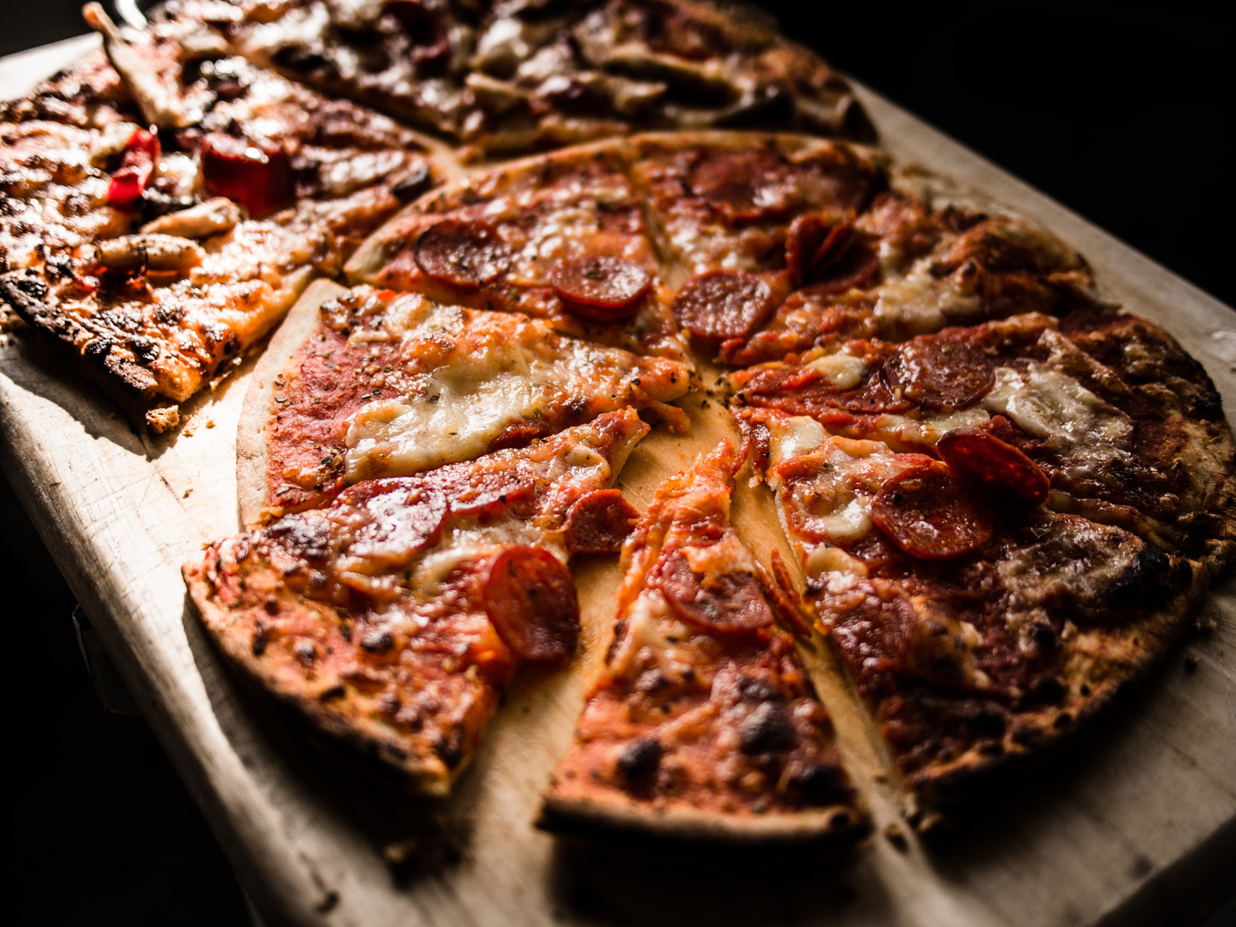
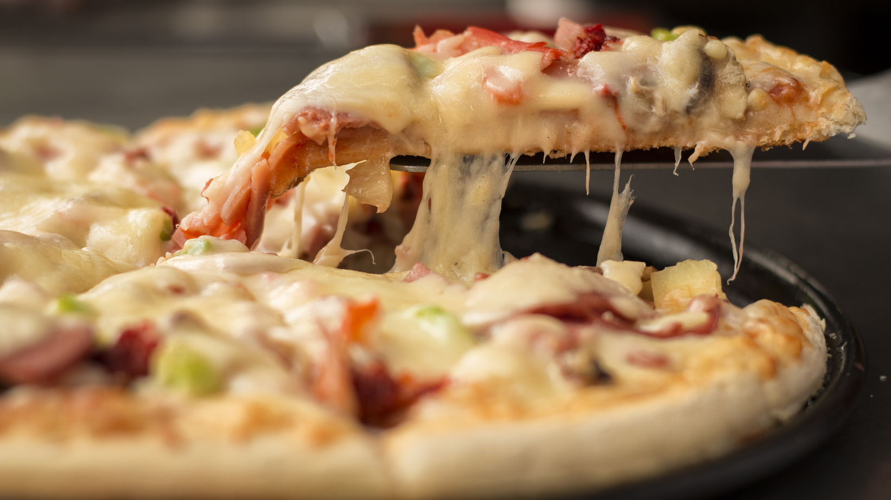
ADVANCED ANALYSIS RESULTS
Percentage Contribution of Pizza Types
RISK TRANSFER METHODS
Presentations are communication tools that can be used as demonstrations, lectures, speeches, reports, and more.

Slide 13
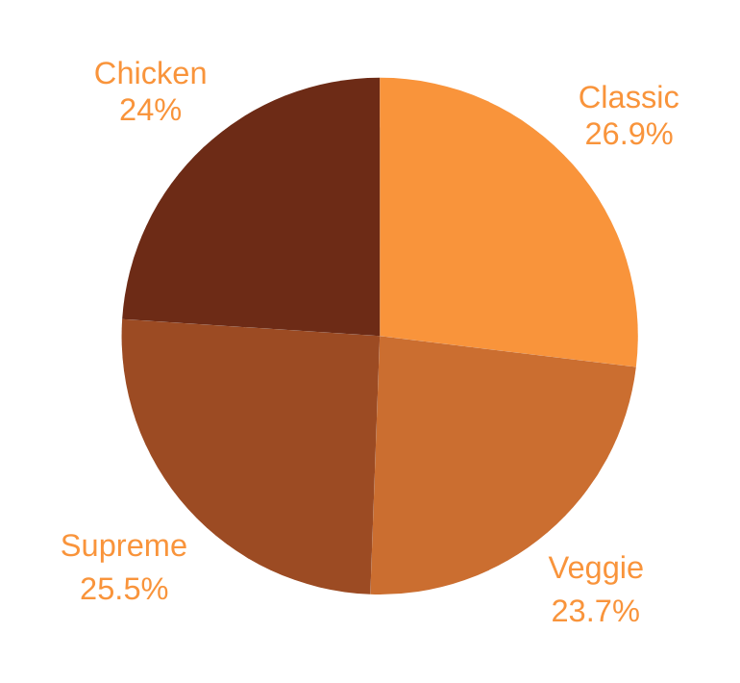
PERCENTAGE CONTRIBUTION
OF PIZZA TYPES
ADVANCED ANALYSIS RESULTS

Slide 14
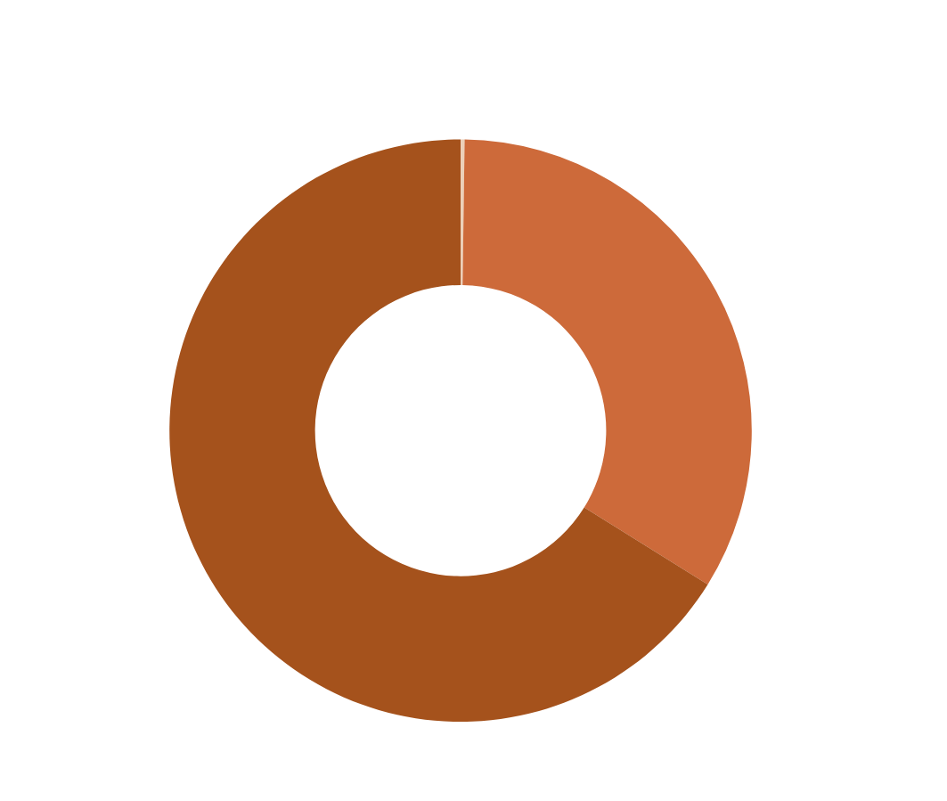
CUMULATIVE REVENUE OVER TIME

Slide 15
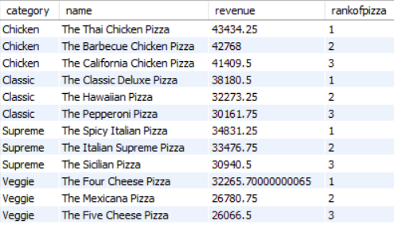
Top 3 Pizza Types by Category

Slide 16
CONCLUSION
In conclusion, the analysis of pizza sales data revealed valuable insights into customer preferences, order patterns, and revenue trends, guiding strategic decision-making for business success.

Slide 17
THANK YOU

